Slide 1
Web Security Md. Alamgir Hossain Senior Lecturer, Dept. of CSE, Prime University Mail: alamgir.cse14.just@gmail.com

Slide 2

Secure Sockets Layer (SSL)
Secure Sockets Layer (SSL) is a digital security feature that enables an encrypted connection between a website and a browser.
SSL aims to provide a safe and secure way to transmit sensitive data, including personal information, credit card details, and login credentials.
The SSL protocol can only be used by websites with an SSL certificate, a digital document that validates a site’s identity.
Implementing SSL is essential to boost site security and performance.
Transport Layer Security (TLS) is SSL’s successor.

Slide 3
How Does an SSL Certificate Work?
SSL certificates protect data transfer using two different encryption techniques: asymmetric and symmetric.
To give a better understanding of how those encryption techniques work, here’s an overview of the process:
First, a website owner purchases an SSL certificate from a Certificate Authority (CA) and installs it on their site.
When a visitor navigates through the website, the browser and the web server establish an SSL connection using a method called SSL handshake.
During the SSL handshake, the browser asks the server for its SSL certificate and public key to prove its validity.
Once the certificate is verified, the browser and web server exchange private and public keys to create a symmetric session key.

Slide 4
How Does an SSL Certificate Work?

Slide 5
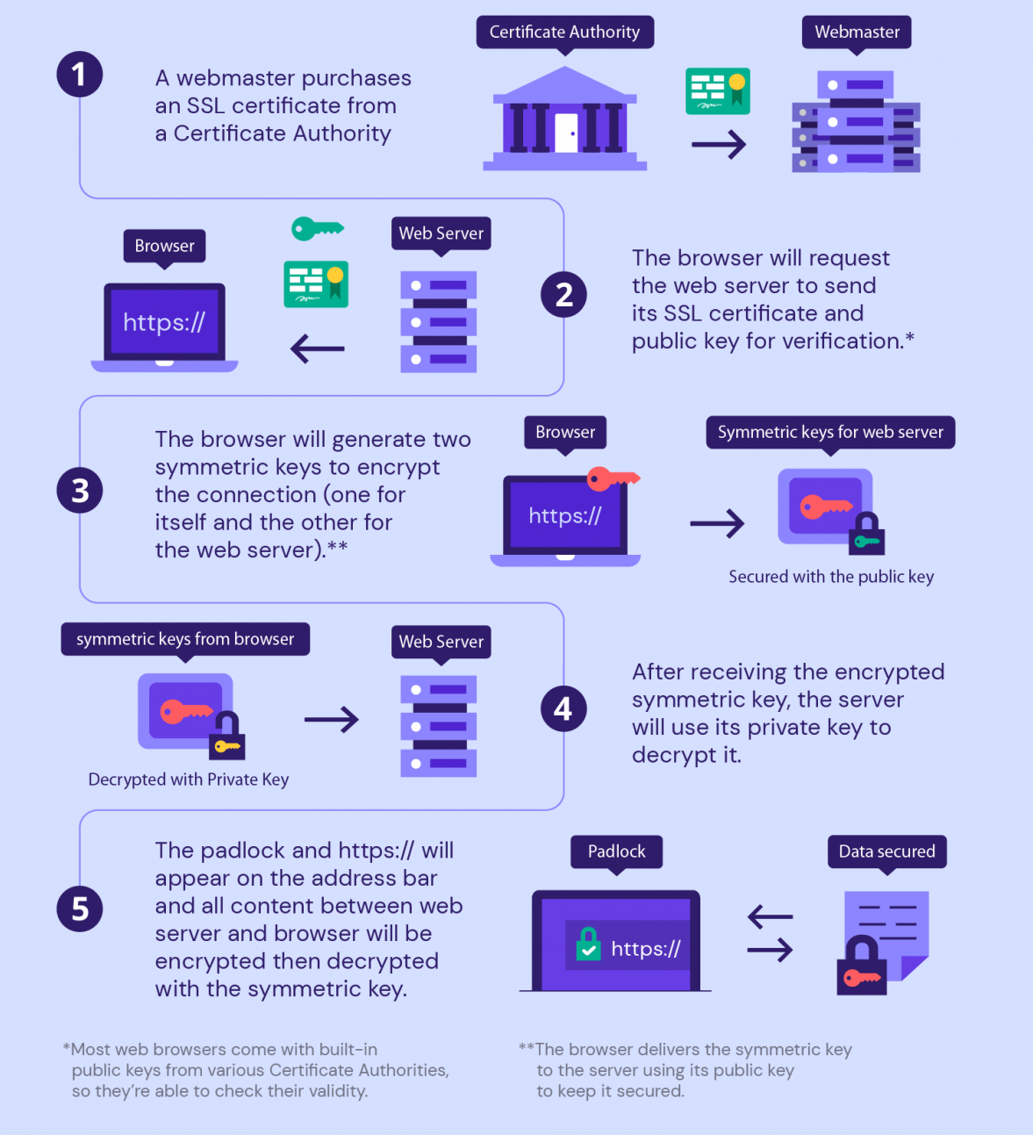

Slide 6
How Does an SSL Certificate Work?
Both parties then use this symmetric key to encrypt all communications. This key will remain valid for a limited time and only for that particular session.
Once the SSL protocol has been enabled, the website will be secure and encrypted. Unauthorized third parties will no longer be able to intercept its communication.

Slide 7
SSL Handshake Protocol
Handshake Protocol is used to establish sessions. This protocol allows the client and server to authenticate each other by sending a series of messages to each other. Handshake protocol uses four phases to complete its cycle.
Phase-1: In Phase-1 both Client and Server send hello-packets to each other. In this IP session, cipher suite and protocol version are exchanged for security purposes.
Phase-2: Server sends his certificate and Server-key-exchange. The server end phase-2 by sending the Server-hello-end packet.
Phase-3: In this phase, Client replies to the server by sending his certificate and Client-exchange-key.
Phase-4: In Phase-4 Change-cipher suite occurs and after this the Handshake Protocol ends.

Slide 8
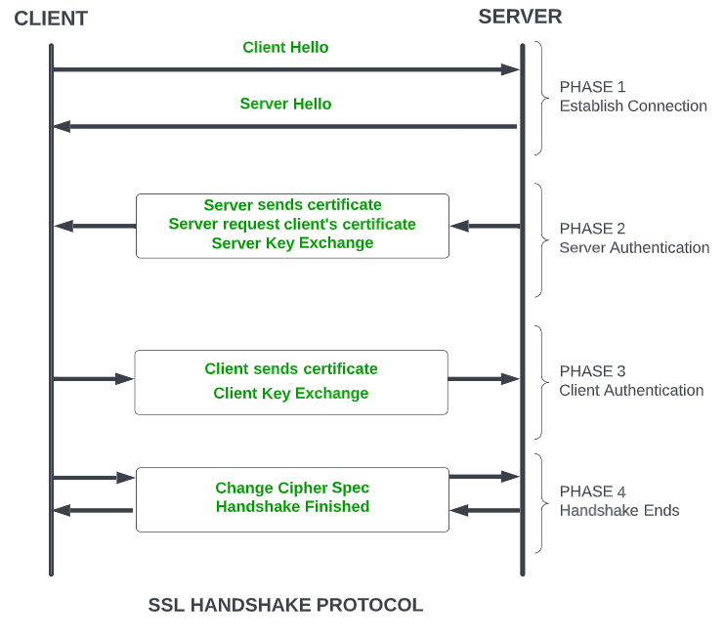
SSL Handshake Protocol

Slide 9
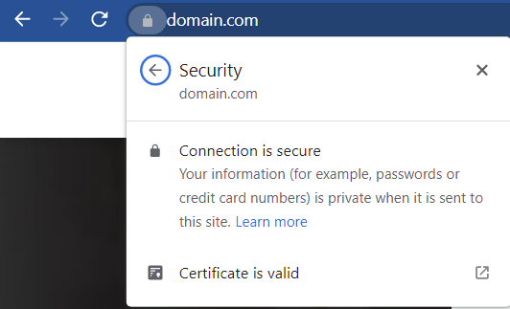
Website Uses the SSL Protocol/Not
It’s possible to know whether a website uses the SSL protocol by looking for a padlock icon on your browser’s address bar.
Click on the icon to view detailed information about the digital certificate, such as the issuer and valid date. Here’s what it looks like on Google Chrome:

Slide 10
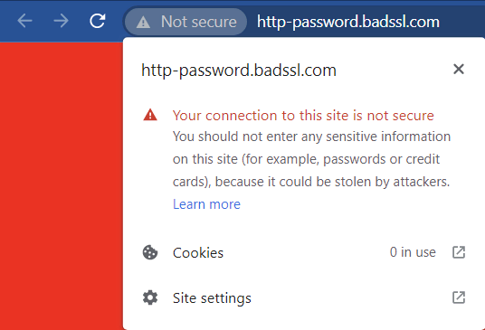
Website Uses the SSL Protocol/Not
On the other hand, the browser will display a “not secure” warning for non-HTTPS sites.

Slide 11
Website Uses the SSL Protocol/Not
Since web browsers actively warn people to avoid unsecured sites, it’s in your best interest to install an SSL certificate and make your website secure.
That way, visitors can instantly see that your site is reliable.

Slide 12
How Does SSL Relate to HTTPS?
URLs are preceded by either HTTP (Hypertext Transfer Protocol) or HTTPS (Hypertext Transfer Protocol Secure).
These protocols effectively determine how data you send and receive is transmitted.
Websites with no SSL certificate will run on HTTP and transfer data in plain text, meaning anyone on the internet can intercept and retrieve the message.
This can cause problems if the transmitted data contain confidential information, which attackers can use to commit cyber crimes such as a data breach, cyber extortion, and identity theft.

Slide 13
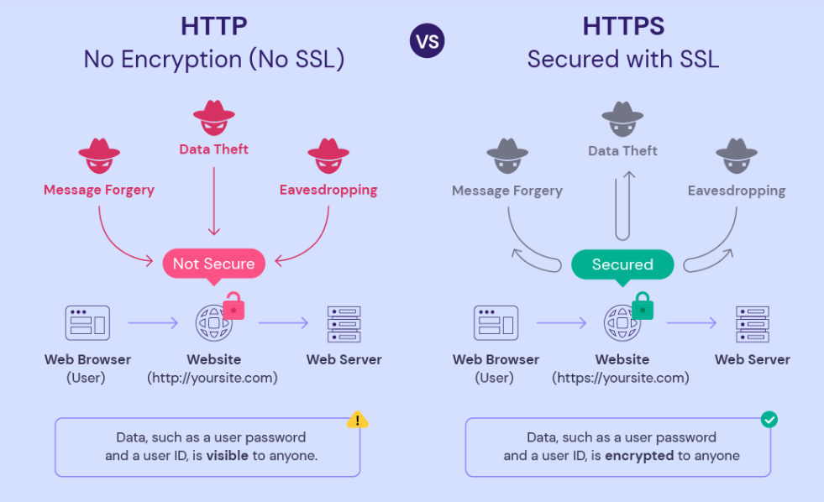
How Does SSL Relate to HTTPS?

Slide 14
How Does SSL Relate to HTTPS?
When you set up an SSL certificate, you configure it to transmit encrypted data using HTTPS. The two technologies go hand in hand – you can’t use one without the other.
Since HTTPS connections require a certificate to work, look if the site uses an HTTPS web address to identify whether it implements the SSL protocol.

Slide 15
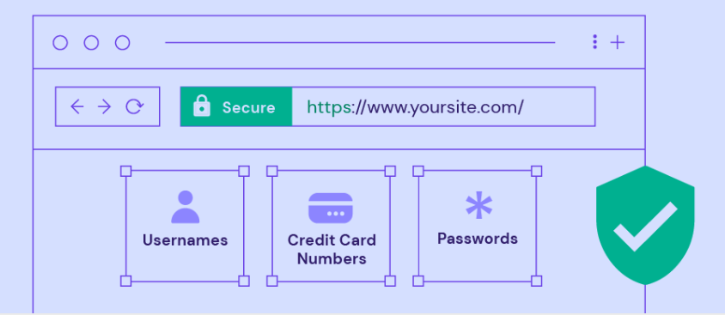
When and Why Is SSL a Must?
SSL is a must for websites handling sensitive information such as usernames, passwords, or credit card numbers.
SSL encryption ensures that only one person – the intended receiver – can decrypt the transferred data.

Slide 16
Some Additional SSL Benefits
Authentication: Any website can pretend to be yours in an attempt to intercept the information that people transmit along the way. SSL enables you to prove your site’s identity.
Data integrity: SSL ensures the transferred data hasn’t been compromised or modified while in transit.
Trust building: Using an SSL certificate is a way of showing visitors that they can trust your site, especially if you run an eCommerce site dealing with online transactions.
PCI compliance: If your site handles online payments, you must comply with the Payment Card Industry (PCI) guidelines, which include having an SSL certificate.

Slide 17
Different Types of SSL Certificates
Single-domain SSL certificates: This type of certificate only protects one domain and can’t be used for its subdomains.
Wildcard SSL certificates: It secures a domain and all its subdomains.
Multi-domain SSL certificates (MDC): This certificate protects multiple domain names and their subdomains.
Unified communications certificates (UCC): A UCC is a type of multi-domain certificate specifically designed for sites hosted on Microsoft Exchange and Live Communications servers.

Slide 18
Different Types of SSL Certificates
There are also different types of SSL certificates based on their authentication levels, such as:
Domain Validation (DV SSL): Domain-validated certificates are the most cost-effective. To obtain it, website owners only need to prove their domain ownership.
Organization Validation (OV SSL): Organization-validated certificates provide a higher level of validation since only legitimate businesses and organizations can use them.
Extended Validation (EV SSL): Extended Validation certificates offer the highest level of validation and are the most expensive among the three.

Slide 19
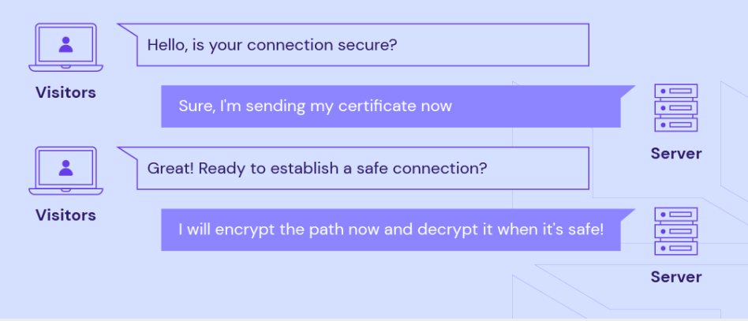
Different Types of SSL Certificates

Slide 20
Thank You

